Slide 1


LlamaAffinity: a compact sequence-only model for antibody binder propensity
Md Delower Hossain^{1,2}, Ehsan Saghapour^{2,3}, Kevin Song^{2,4}, Jake Y. Chen^{1,2,3,4}
¹ Computer Science Dept. ²Systems Pharmacology AI Research Center (SPARC)
³ Biomedical Informatics & Data Science Dept. ⁴ Biomedical Engineering Dept.
Sep 10th 2025

Slide 2
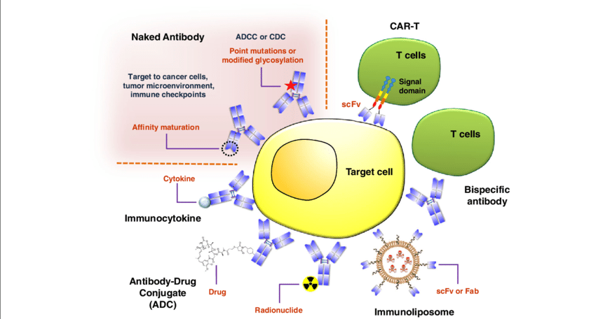
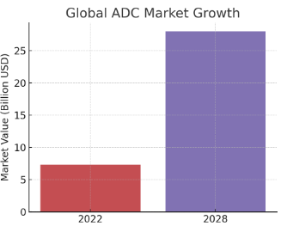
Motivation: Antibody as a therapeutic modality
Lu, RM., Hwang, YC., Liu, IJ. et al. Development of therapeutic antibodies for the treatment of diseases. J Biomed Sci 27, 1 (2020). https://doi.org/10.1186/s12929-019-0592-z

Slide 3
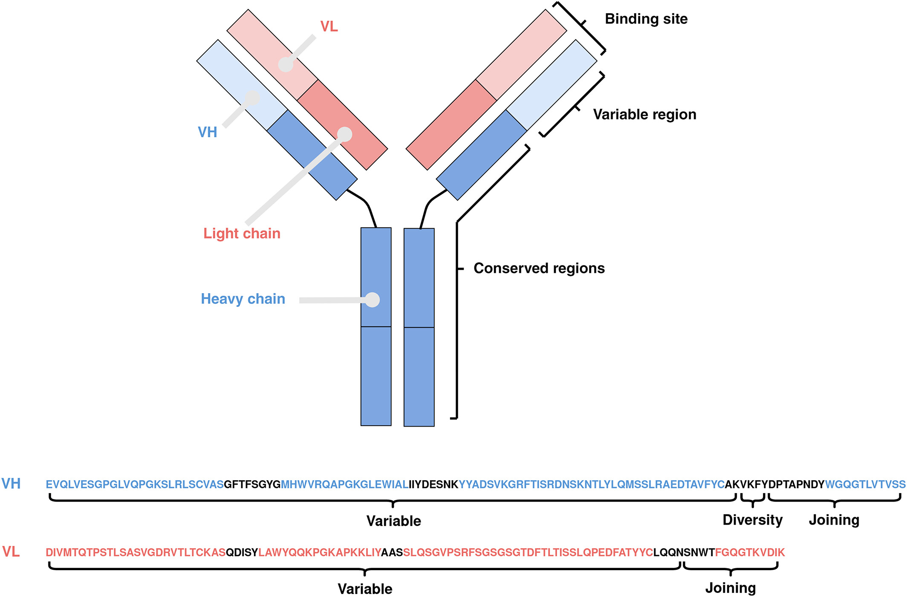
Research Problem: “Can we improve antibody binding affinity predictions?”
Accurate prediction of antibody–antigen binding affinity remains a challenge due to sequence diversity, structural complexity, and limited labeled datasets.
Existing models (e.g., AntiBERTa, AntiFormer) struggle to balance prediction accuracy with computational efficiency.
There is a need for custom fine-tuning approaches (like LLaMA backbones) that can better capture antibody sequence representations for robust affinity prediction.
T. H. Olsen, F. Boyles, C. M. Deane in Protein Science(2022)

Slide 4
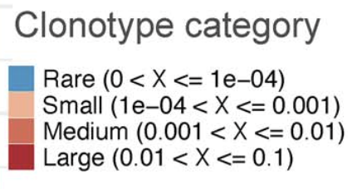
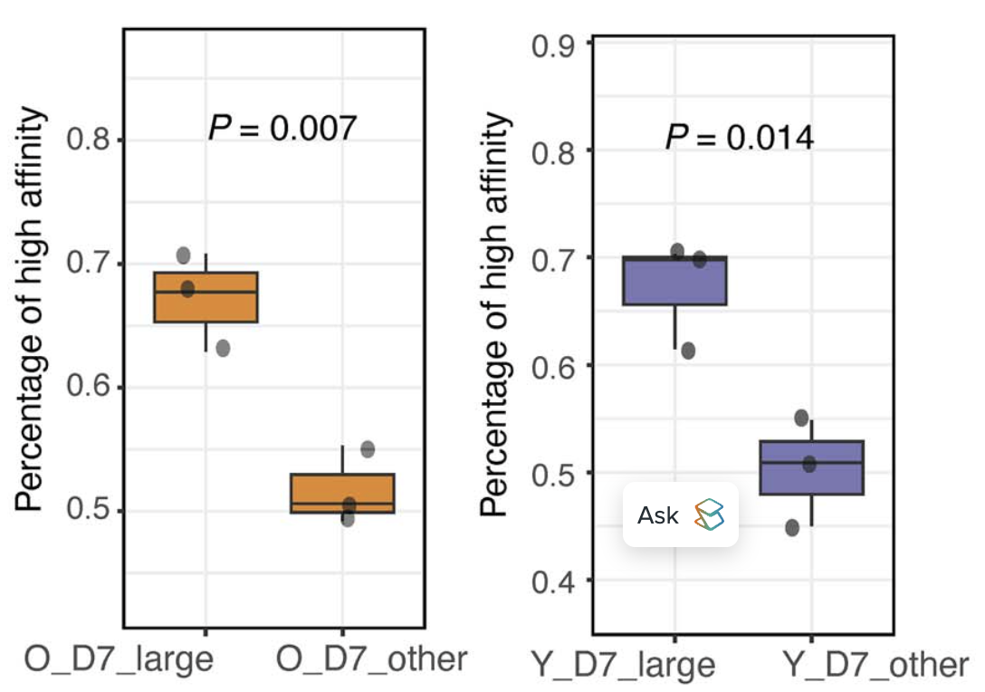
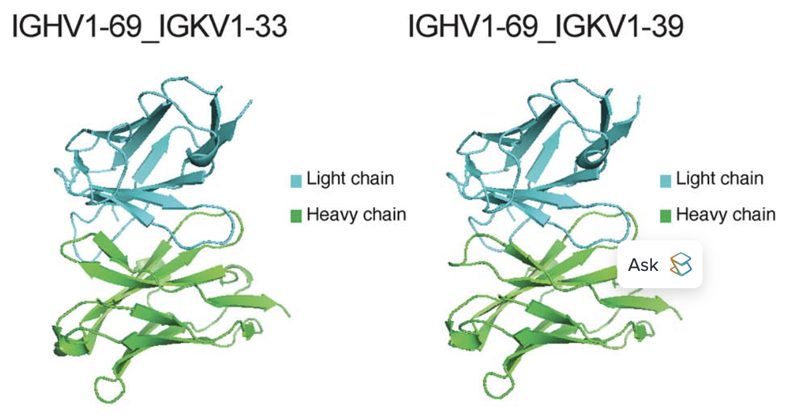
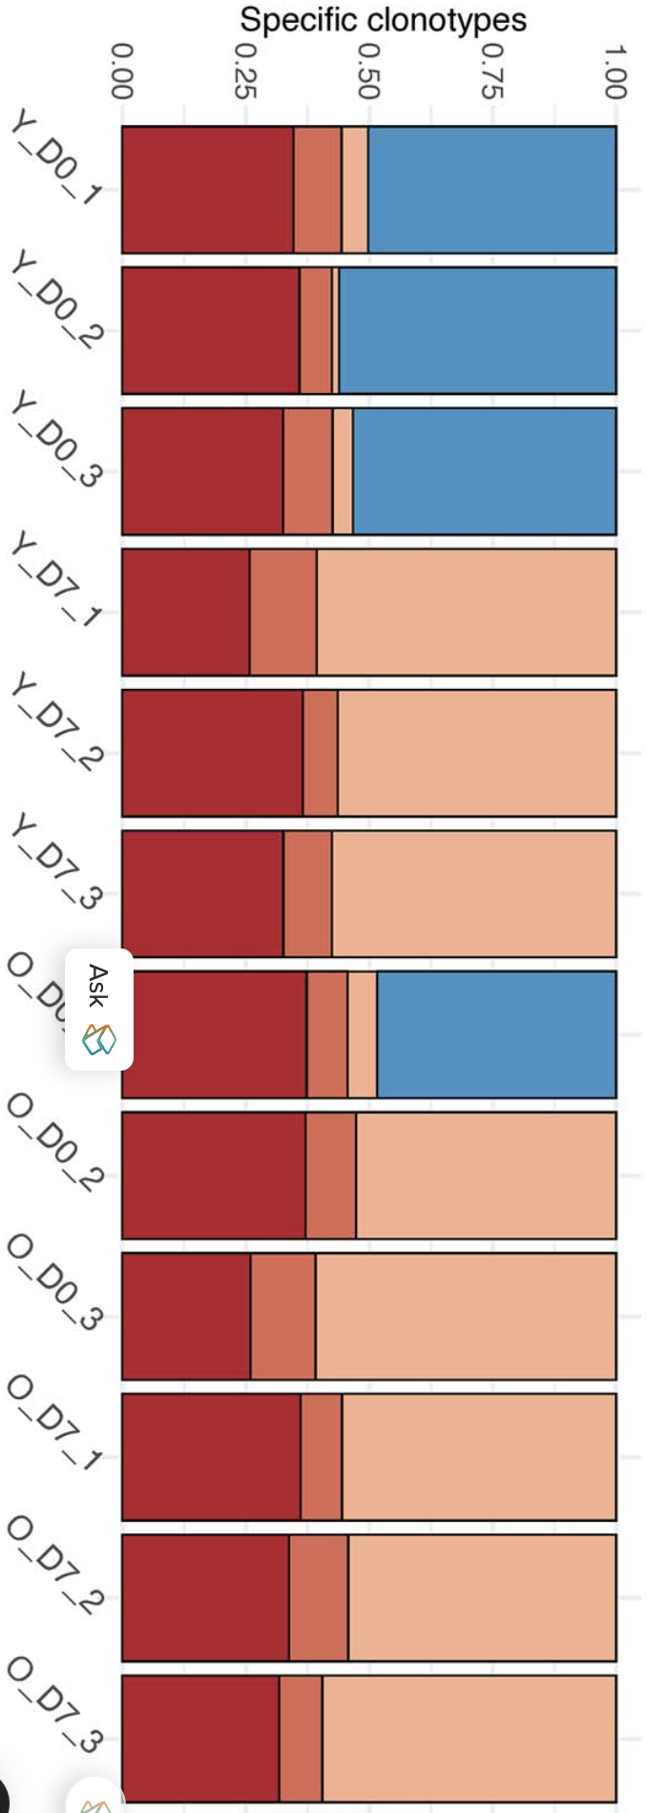
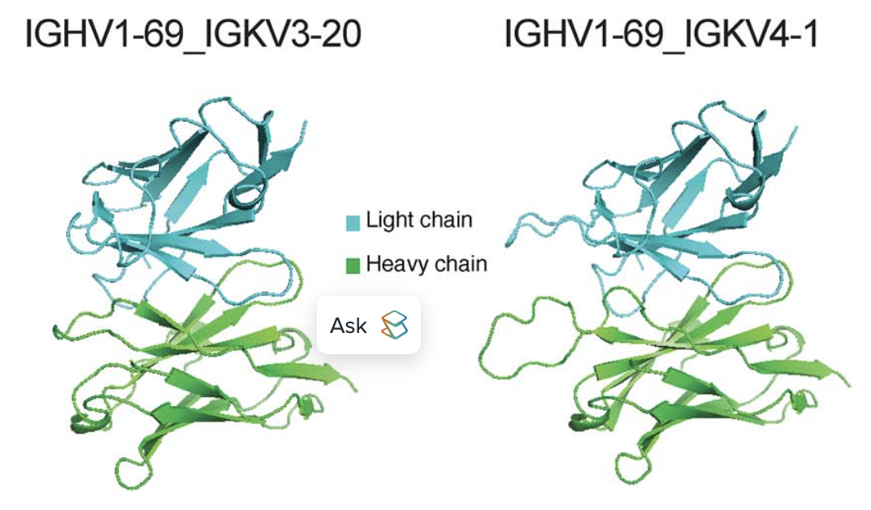
Clonotype expansion, bindability prediction, and structural stability
The average pLDDT scores for AlphaFold2 predicted antibody structures (all) > 92
Before Immunization (D0)
Y_D0
Youth (Y)
Y_D7
A COVID-19 immunization case study
O_D0
Adult (O)
After Immunization (D7)
O_D7
Wang et al. in Briefings in Bioinformatics, 2024, 25(5): bbae403

Slide 5
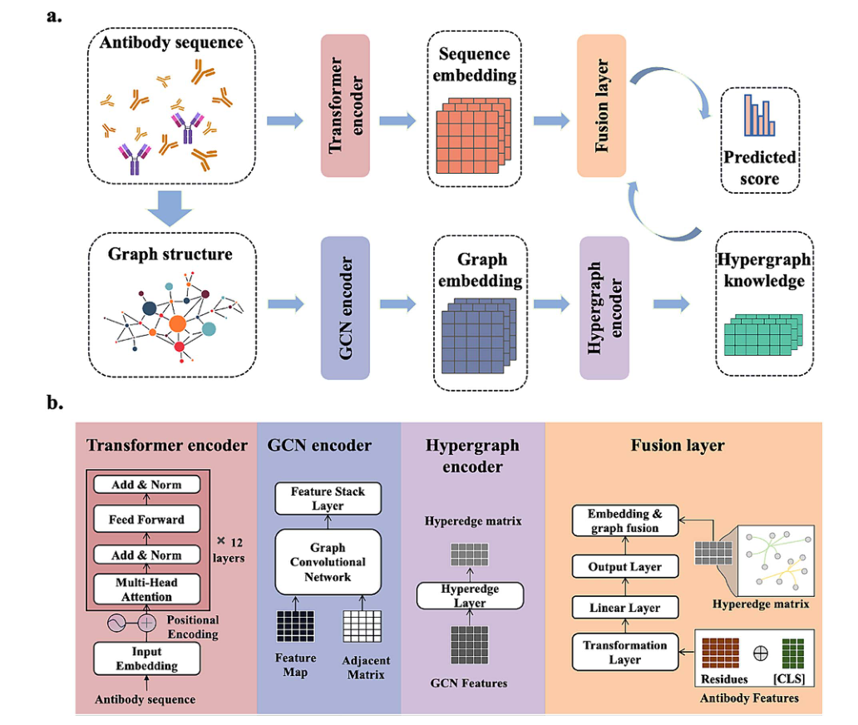
AntiFormer: the SOTA Model in 2024
Architecture:
Dual-flow — Transformer + GCN→hypergraph –fused for prediction.
Inputs:
Paired heavy+light chains from the OAS DB
Reported performance:
Accuracy 91.69%, AUROC 0.966;
>> AntiBERTa and AntiBERTy.
Training time:
AntiFormer 0.76 h < AntiBERTy 1.46 h < AntiBERTa 2.97 h.
Wang et al. in Briefings in Bioinformatics, 2024, 25(5): bbae403
Source: Wang et al., Fig. 1 (model overview, dual-flow). Page 3.

Slide 6
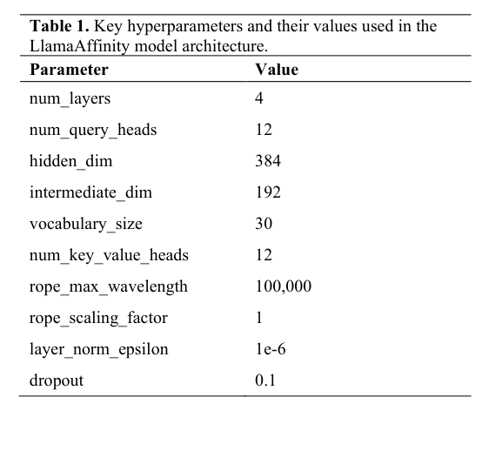
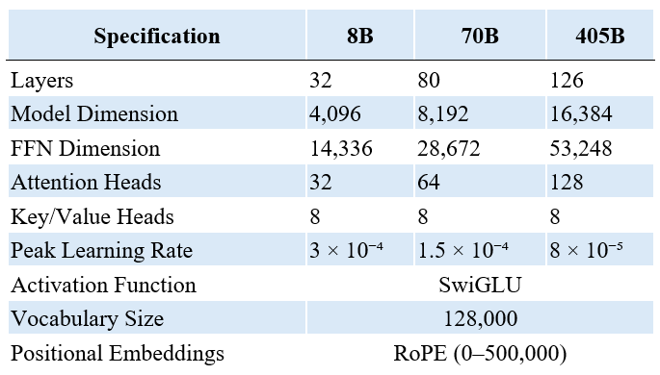
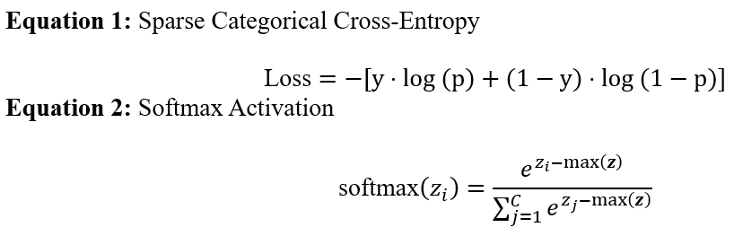
LlamaAffinity: our approach to a compact baseline
Goal
Llama 3 Configuration
Simple, fast, reproducible baseline under AntiFormer’s label setting
Our New Model
Compact Llama3-style encoder + global pooling + binary classifier head
Key Hyperparameters
Source: Llama 3 technical report
4 layers; 12 Q-heads/12 KV-heads; hidden 384; intermediate 192; dropout 0.1; vocab ≈30
LlamaAffinity v1: Table 1 (hyperparameters)

Slide 7
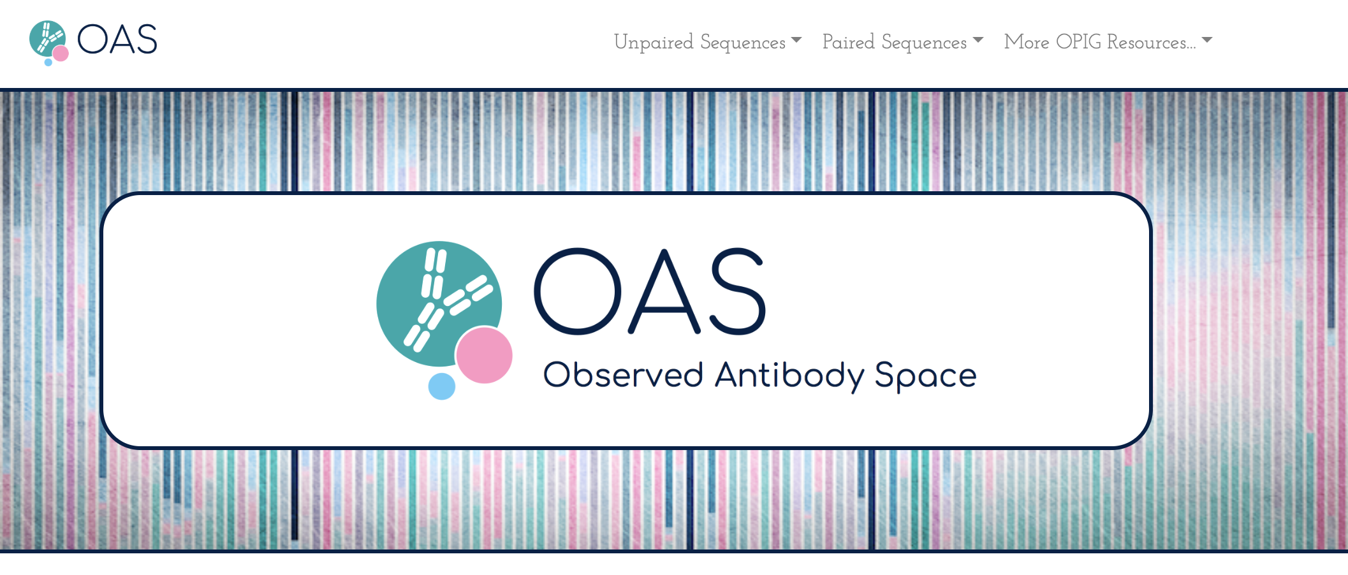
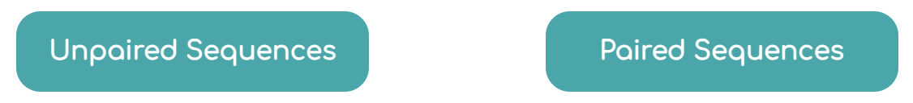
Training Data Set: Paired H and L chain sequences from the OAS DB (https://opig.stats.ox.ac.uk/webapps/oas/)
>1000M
Unpaired
Sequences
>80
Immunology Studies
>120K
Unpaired
Sequences
7
Immunology Studies
T. H. Olsen, F. Boyles, C. M. Deane in Protein Science(2022)

Slide 8
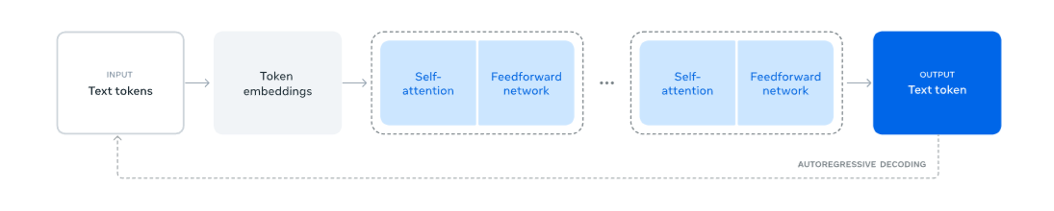
The LlamaAffinity Antibody Affinity Modeling Pipeline
Dataset:
Heavy and light chain amino acid sequences are used as inputs; sequences above the 85th redundancy percentile are labeled as binders, while those below are labeled as low-affinity. Data was compiled from OAS DB
Model Architecture:
“Llama3 Style” Backbone (Custom Training & Configuration), Detailed configuration in the next slide.
Inputs are tokens of amino acid sequence, where the output is binder (1) or low affinity (0).
Data Split:
5-fold cross-validation
Preprocessed data was employed from the AntiFormer official repository.
Training Phase:
Five-fold stratified cross-validation was performed over 10 epochs on a Google Collab GPU.
LlamaAffinity training follows the Llama3 model training workflow
Source: Llama 3 technical report

Slide 9
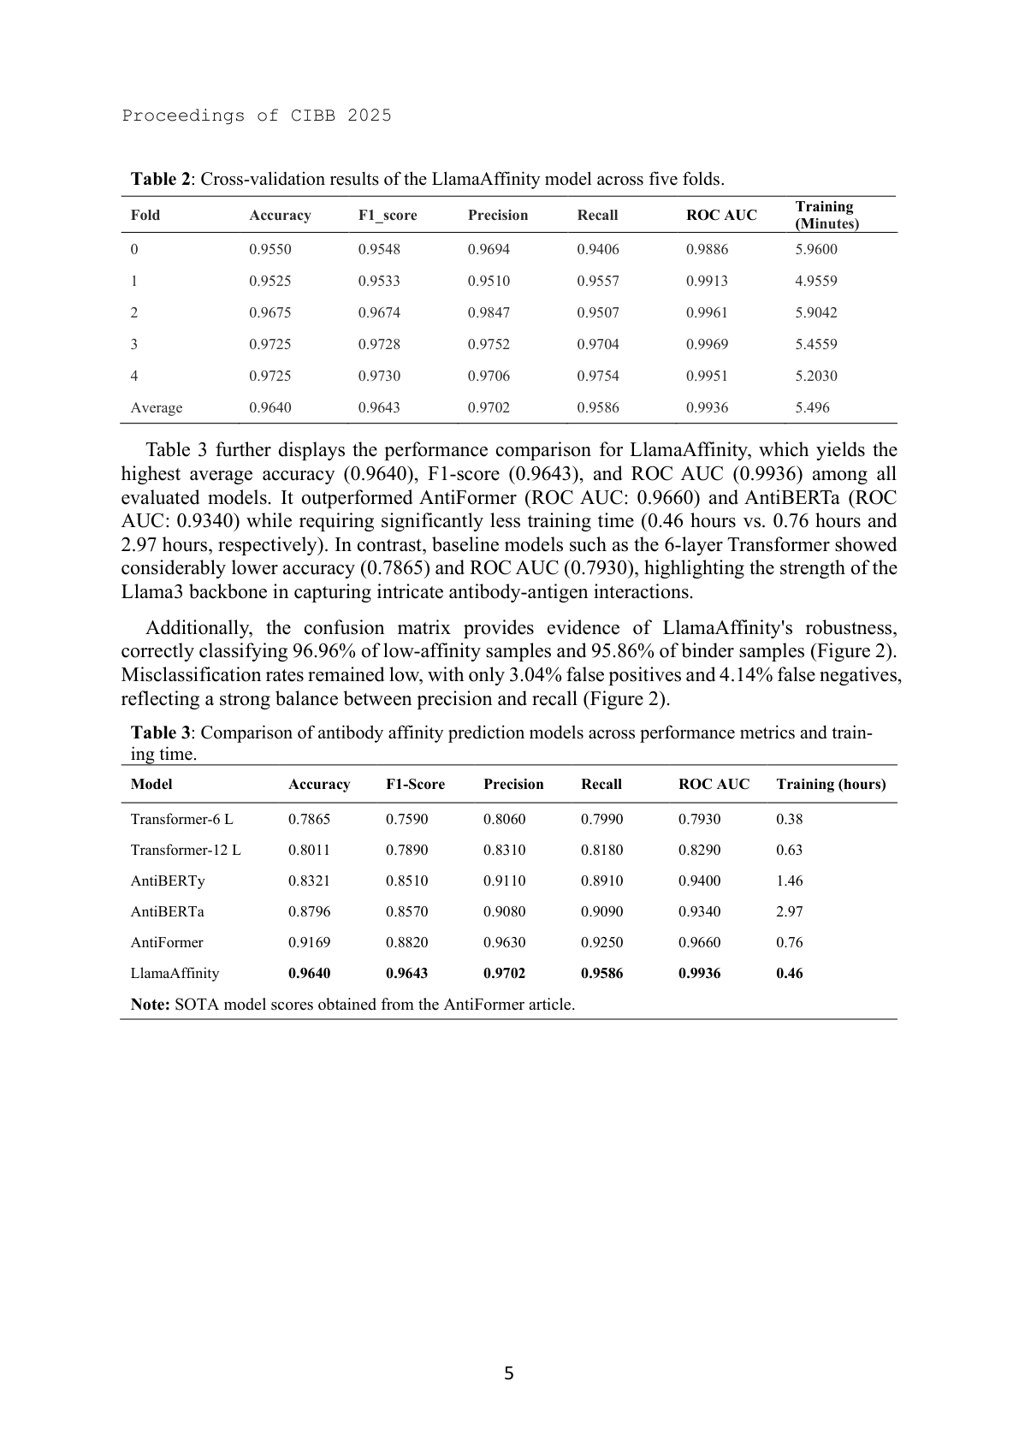
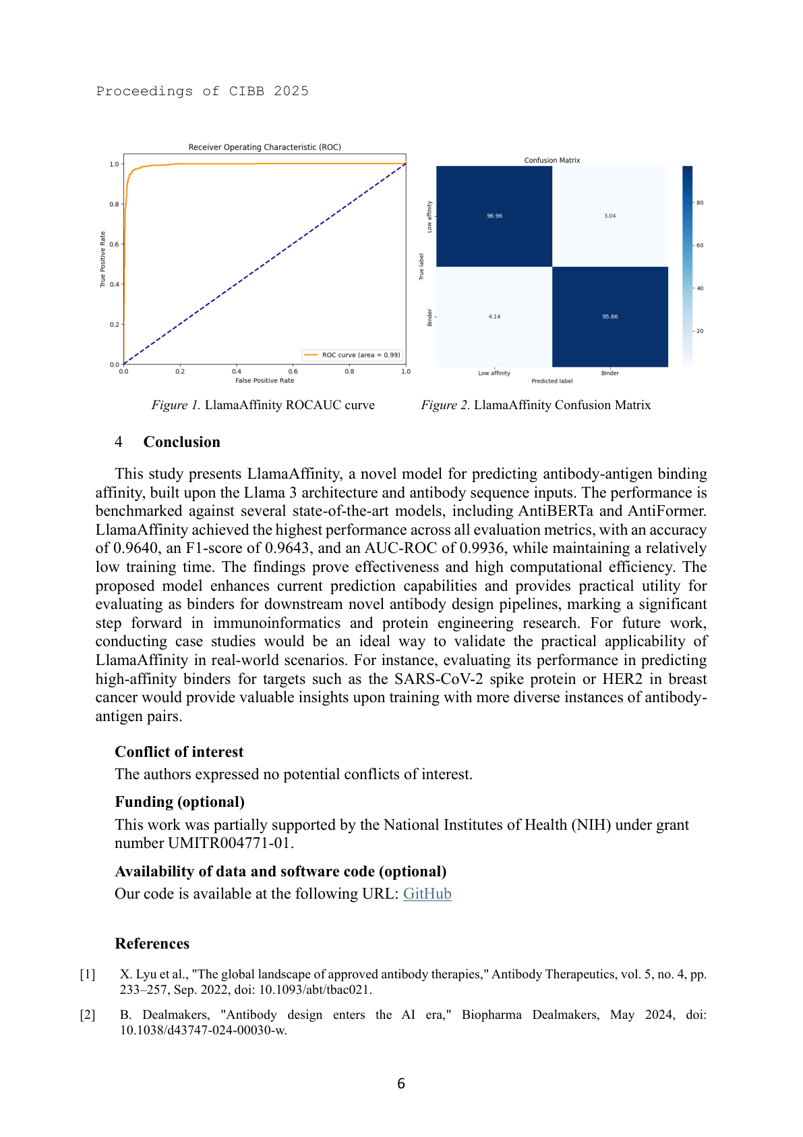
Results: Model Performance and Comparisons
5-fold cross-validation
<5% error rate made in silico prediction practical
LlamaAffinity v1: Table 2 (fold-wise metrics & averages), p.5

Slide 10
Results: Model Performance and Comparisons
The average training time was ~27.5 minutes, 65% faster than the AntiFormer model.
1st
2nd
LlamaAffinity v1: Table 2 (fold-wise metrics & averages), p.5

Slide 11
Discussion
Accuracy & error: >96% accuracy (<5% error) under 5-fold CV on OAS-derived labels
Speed: ~27.5 min total for 5 folds on a single Collab-class GPU → rapid iteration
Simplicity: Sequence-only encoder + pooling → fewer moving parts, lower variance
Why it works here: Proxy labels reflect motifs/germlines; strong intra-sequence encoder captures most signal; extra graph layers can add noise.
Scalability: Efficiency + simplicity enable scaling to ~1B unpaired OAS DB sequences to assess intrinsic bindability
Therapeutic upside: With antigen info (sequence/structure), extend to antigen-specific optimization
Architecture comparison: AntiFormer’s GCN→hypergraph branch is less effective here; simpler baseline evolves with the foundation-model frontier
Generalization caveat: Current task = binder propensity from sequence, not calibrated K_D; results may drop under clone-aware or target-held-out splits and on orthogonal assays.
Benchmarking caveat: Cross-paper baseline numbers are as reported; apples-to-apples re-runs on identical splits/hardware are the fairest comparison.

Slide 12



Acknowledgments
Systems Pharmacology
AI Research Center
Manuscript & GitHub Repository
Ehsan Saghapour, Ph.D.,
Radomir Matthew, MD, Ph.D Student
Sharma, Rahul, Ph.D
Kevin Song, Ph.D Student
Fuad Al Abir, Ph.D Student
Md Delower Hossain, Ms, MBA, Ph.D. Student
Zhandos Sembay, MS
Melissa Hall, MS
Hari Merla, MS
Andrew Trotter, MS
Maryam Choucha, MS
NIH Grants
U54OD036472,
1OT2OD032742,
UMI-TR004771

